Slide 1
Generics
Generics
What are they?
Why do we need them?

Slide 2
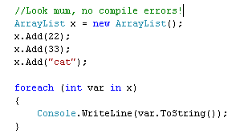
Generics DEMO 1
Why do we need generics?
Reason 1: Type safety
Notes:
Time: 1 min

Slide 3
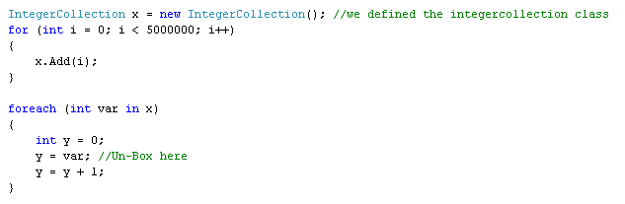
Generics DEMO 1
Why do we need generics?
Reason 2: Performance
Notes:
Time: 1 min

Slide 4
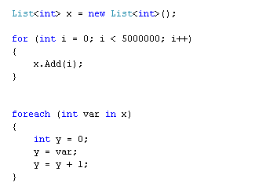
Generics DEMO 1
What are generics?
Generics are a feature of the common language runtime that allows classes, structures, interfaces, and methods to have placeholders (generic type parameters) for the data types they store and manipulate.
Notes:
Time: 1 min

Slide 5
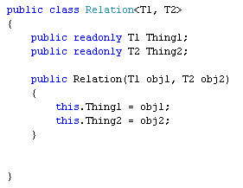
Generics DEMO 2
Example: Generic Parameters
The Types for placeholders T1 and T2 are determined at runtime based on how the relation object is declared and instantiated .
Notes:
Time: 1 min

Slide 6
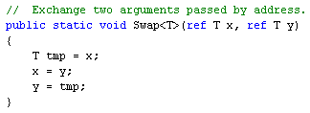
Generics DEMO 3
Example: Generic Methods
The Type of placeholder T is determined at runtime based on how the method is called .
Notes:
Time: 1 min

Slide 7
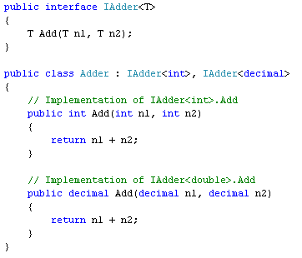
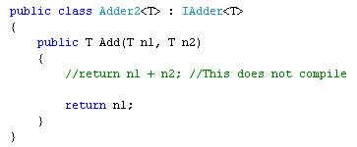
Generics DEMO 4
Example: Generic Interfaces
Any class implementing IAdder can resolve the type (or Not, ie can allow the caller to resolve the type).
Notes:
Time: 1 min

Slide 8
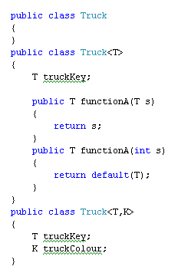

Generics DEMO 5
Example: Generics and overloading
As normal, can overload methods, but can kind of overload classes too!
Notes:
Time: 1 min

Slide 9
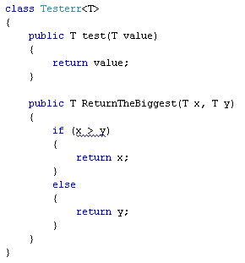
Generics DEMO 6
Generics and Constraints
What’s wrong here?
Notes:
Time: 1 min

Slide 10
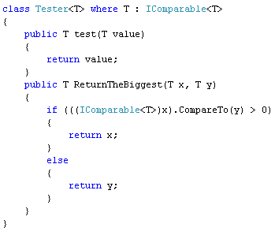
Generics DEMO 6
Generics and Constraints
The interface Constraint mandates that T must inherit from a given interface. In this case IComparable
Notes:
Time: 1 min

Slide 11
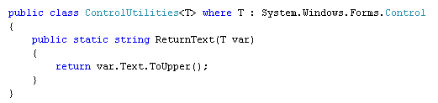
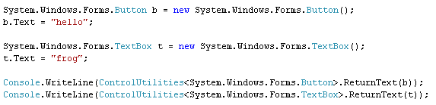
Generics DEMO 7
Generics and Constraints
The inheritance Constraint mandates that T must inherit from a given class. In this case, the Control class.
Notes:
Time: 1 min

Slide 12
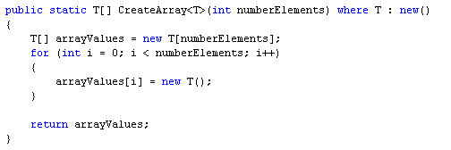
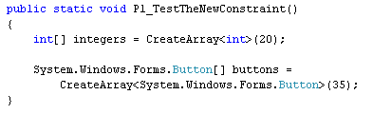
Generics DEMO 8
Generics and Constraints
The ‘new’ Constraint adds the requirement that the type passed as the generic parameter has public parameter-less constructor
Notes:
Time: 1 min

